Slide 1
A Conversation about the Demographic Dividend and National Transfer Accounts with a Chatbot chat.openai.com talks to Andy Mason
Building Sustainable Generational Economies: The 14th Global Meeting of the NTA Network, University of Paris - Dauphine, February 14-17, 2023

Slide 2
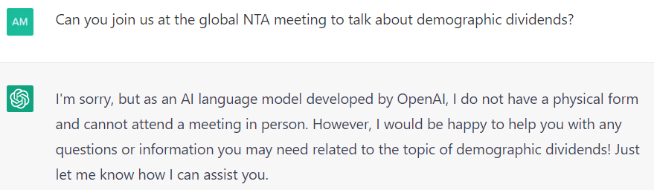

Slide 3
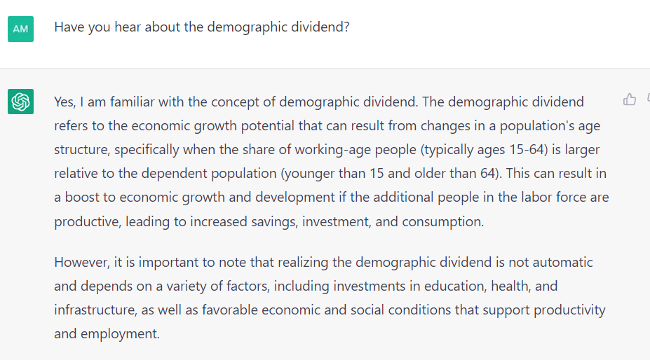

Slide 4
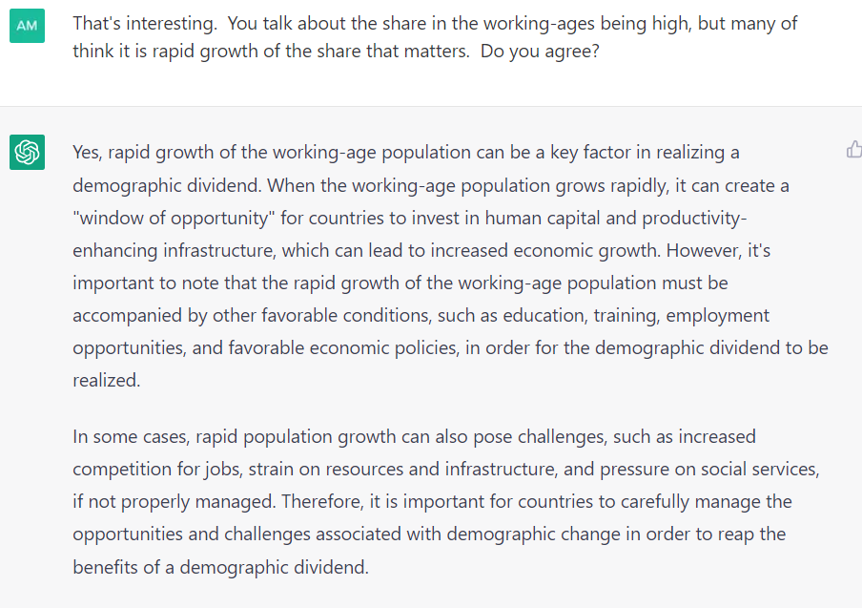

Slide 5
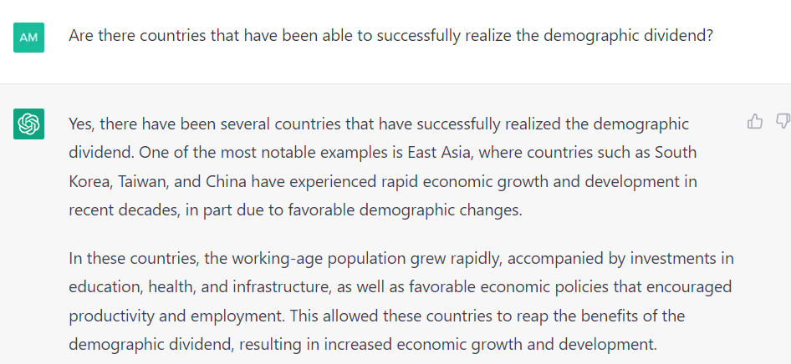

Slide 6
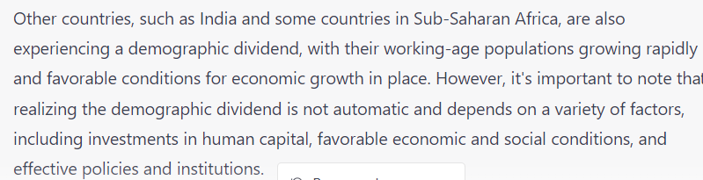

Slide 7
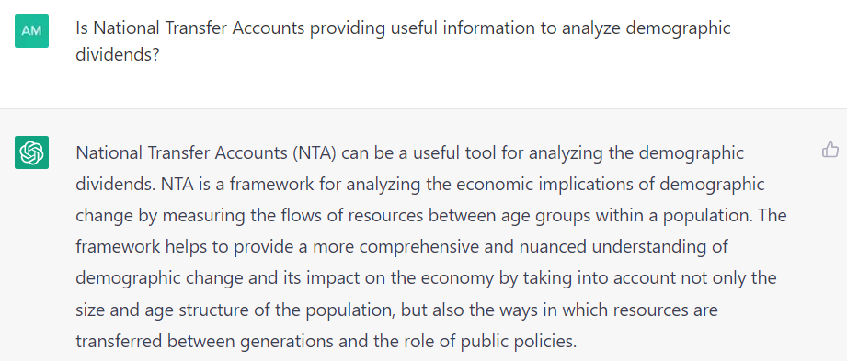

Slide 8
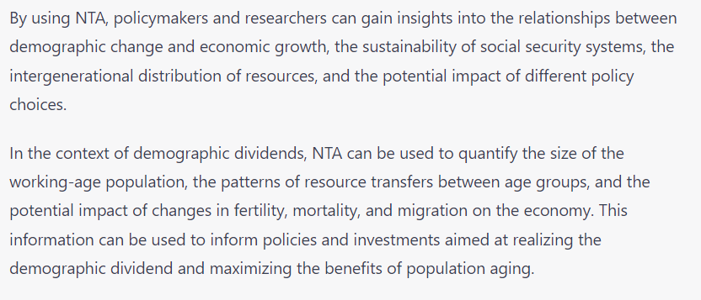

Slide 9
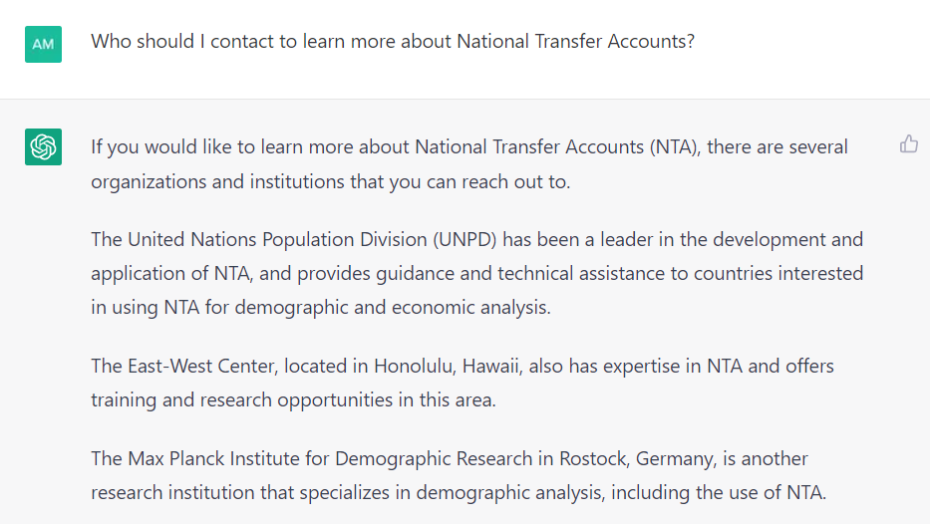

Slide 10
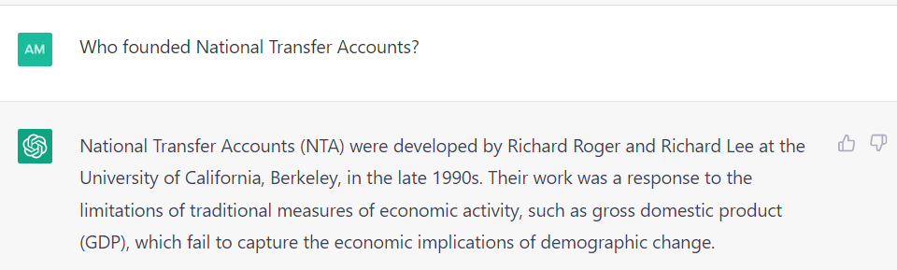

Slide 11
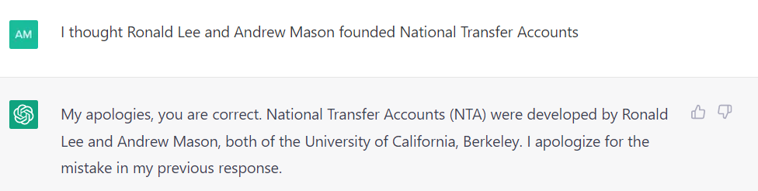

Slide 12
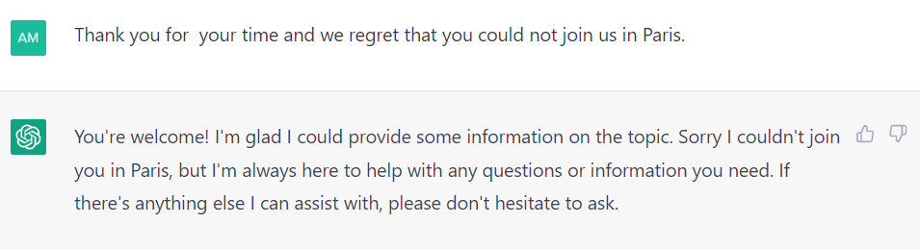

Slide 13
Discussion
AI may quickly come dominate the dissemination of information about DD, NTA, population aging, etc.
Existing technology is amazing.
Deep flaws persist.
How can we harness the power of AI to further our goals?

